Slide 1
ALIGNMENT OF COURSE OUTLINES TO COMPETENCY BASED CURRICULUM
Charity Limboro (PhD)
Pedagogy Training
Tharaka University
August 16th, 2021.

Slide 2
What is Competency Based Curriculum?
Competence-Based Curriculum (CBC) focuses on all-round outcomes in relation to knowledge, skills and attitudes that learners acquire rather than focusing on teachers’ coverage of content.
The curriculum is learner-centred and adaptive to the changing needs of learners, teachers, and society.
It is designed around a set of key competencies as prescribed under the 21st Century skills. communication, collaboration, critical thinking and problem solving, and creativity and imagination, as well as self-efficacy, citizenship, digital literacy, and learning to learn (Kenya Institute of Curriculum Development, 2017).

Slide 3
It is also an approach to education that emphasizes on acquisition of life skills and evaluates the mastery of skills necessary for a learner to function efficiently in his/her society (Savage, 1993).
According to Mosha (2012), CBC is meant to develop in learners the ability to learn, to carryout prescribed tasks, and learn to work with other people.
Thus, competence-based curriculum foregrounds individual child’s abilities in the learning process, calls for change in teaching, learning, conducive environments and continuous assessment approaches (see Posner, 1995).

Slide 4
Notably, Competency-Based Education has been embraced in many counties as an education quality improvement strategy in many counties (Rwanda, South Africa, Tanzania, and Scandinavian countries) with varying degrees of success.
Why align course outlines to CBC?

Slide 5
IMPLICATIONS OF CBC ON UNIVERSITY PROGRAMMES
COMPETENCY-BASED APPROACH | IMPLICATIONS ON UNIVERSITY PROGRAMS
COMPETENCY BASED CURRICULUM APPROACH Shift from knowledge to application (doing) Recommended seven (7) Core-competencies Recommends balanced assessment with more focus on formative assessment | Shift reliance on lectures to use of a broader array of learner –centered instructional strategies Shift from rote learning to competency-based approach Integrate the seven (7) cross-curricular competencies in programmes and courses graduating learners who are empowered, engaged and ethical Shift from reliance on summative to formative assessment. Administer authentic assessment and us rubrics Programmes and Course Units learning outcomes be linked to professional standards and competences in that field

Slide 6
IMPLICATIONS OF CBC ON UNIVERSITY PROGRAMMES
COMPETENCY-BASED APPROACH | IMPLICATIONS ON UNIVERSITY PROGRAMS
2. TRANSITION FROM JUNIOR TO SENIOR HIGH SCHOOL BECF has recommended three (3) Pathways in Senior High School ARTS & SPORTS SOCIAL SCIENCES STEM Each of the 3 Pathways has a number Tracks. | A learner joining Senior High will be - Ready To Launch in Career Readiness. I, the learner will select a Pathway and a Track in Senior School at grade 10 I need to make informed decision on how my selection links to a post-secondary training and potential career. The Universities should provide detailed information on programmes requirements to help a learner make such informed selection. That is the best practice, based on planning with the end in mind. The universities need to interrogate the BECF Pathways and Tracks on how they link to programmes and entrance requirements. The universities commence develop programme information and requirements, make them available and accessible to grade 9 learners and parents.

Slide 7
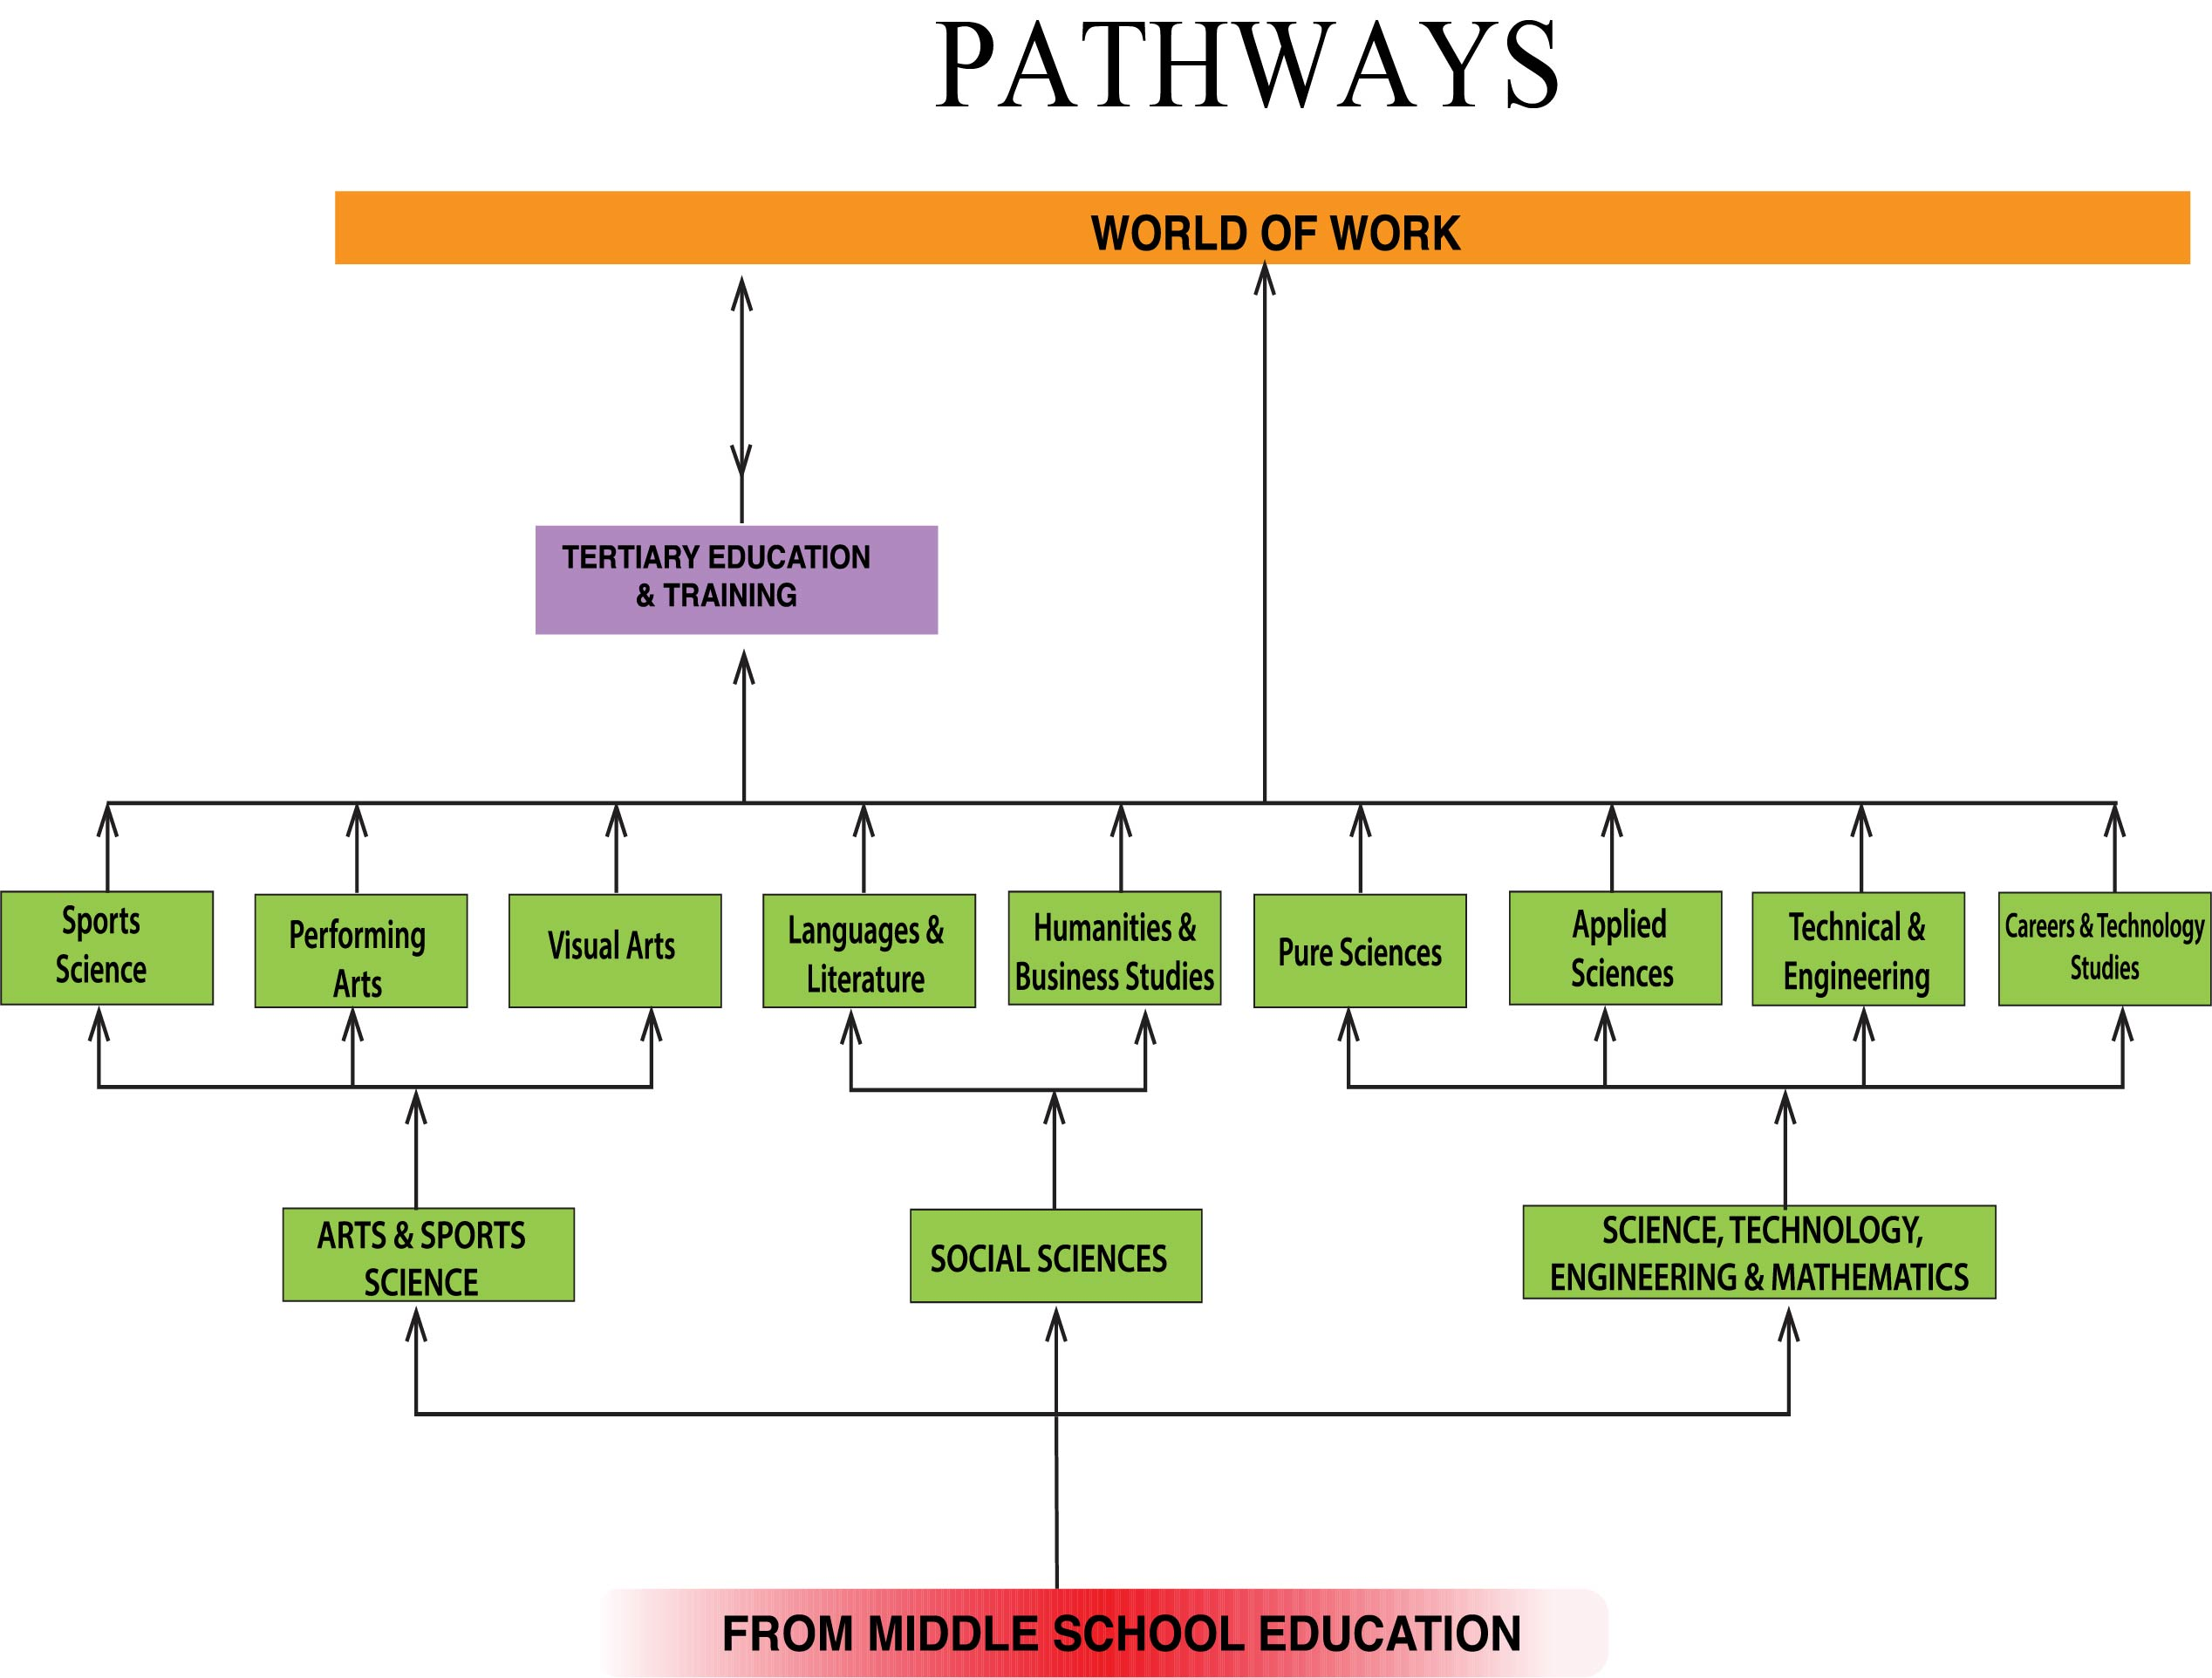
SENIOR HIGH SCHOOL
BBBBBB
FROM JUNIOR HIGH SCHOOL

Slide 8
IMPLICATIONS OF CBC ON UNIVERSITY PROGRAMMES
COMPETENCY-BASED APPROACH | IMPLICATIONS ON UNIVERSITY PROGRAMS
3. PRE-SERVICE TEACHER TRAINING PROGRAMME The MOE QAS, KICD, KNEC and TSC have developed policy frameworks with standards and competencies to support teachers deliver CBC curriculum and acquire 21st century skills. | The university teacher education curriculum should be reviewed to be in tandem with CBC and national education reforms. The reviewed curriculum for BED & PGDE become a standard (minimum) for all schools of education programmes across universities. The reviewed curriculum should integrate the following teaching standards and competencies identified of a 21st teacher, who: Promotes professionalism throughout his/her career. Has the pedagogical content knowledge and understanding of competency-based curriculum Knows how to conduct assessment As, For, and Of Learning and reporting Knows how to create and support inclusive practices and IEP. Knows and promotes a comprehensive school health and safety. Knows and Promotes Instructional Leadership Has Knowledge of Financial Literacy Skills. NB: Prepare on KSA with more focus on Attitudes (values, equity)

Slide 9
IMPLICATIONS OF CBC ON UNIVERSITY PROGRAMMES
COMPETENCY-BASED APPROACH | IMPLICATIONS ON UNIVERSITY PROGRAMS
4. REFORMING TEACHING PRACTICE The teaching practice should be seen as a professional development growth where a pre-teacher takes termly or yearly courses and then followed by a practicum. At the end of the programme, the pre-service teacher would taken X number of practicum experiences and X number of professional courses. Also consider Clinical Supervision approach in pre-service practicum that has been found very powerful process. | The university teacher education programmes should be sequence course work with teaching practice with consideration of a pre-service teacher development and growth. For example a pre-service teacher could take a practicum at the end of each year’s course work, totaling 4 practicums at the end of a 4 year program. Example: Pre-service Teaching Practice Development Year 1: Initiation To Teaching - 25 % teaching load Year 2: Development – 50% teaching load Year 3: Expansion of Teaching Responsibilities – 75% Year 4: Consolidation – 100% Actions: Review the current university teacher education curriculum and practicum. Develop a harmonised TE curriculum Establish a Centre of Teaching and Learning (CTL) in every university to train teacher educators on reviewed curriculum and practicum. The CTL could cascade training in CBC, pedagogy and assessment to all other non-education faculties and departments across the universities.

Slide 10
IMPLICATIONS OF CBC ON UNIVERSITY PROGRAMMES
COMPETENCY-BASED APPROACH | IMPLICATIONS ON UNIVERSITY PROGRAMS
5. TRAINING OF TEACHERS P1 – P2 Trainers Lower Primary Upper Primary Junior High Senior High Pathways ARTS & SPORTS SOCIAL SCIENCES STEM STEM CTS | The university school of education will consider the following. Training BED pre-service teachers to support Senior School teaching subjects. The introduction of Pathways and Tracks will require to expand the programmes. The CTS has a huge implication on teacher training. CTS is a dual credit strategy learning programming where students participate in apprenticeship training obtaining both high school certificate and a career certification.

Slide 11
IMPLICATIONS OF CBC ON UNIVERSITY PROGRAMMES
COMPETENCY-BASED APPROACH | IMPLICATIONS ON UNIVERSITY PROGRAMS
6. TRAINING OF TEACHER EDUCATORS Lecturers for Diploma with specialization on different levels on BASIC EDUCATION | Training lecturers who will teach in diploma colleges preparing teachers with a reformed curriculum that has a concentration aligned to grade levels. . For CTS teachers, best practice will has been to recruit candidates with industry experience to be trained on teacher professionalism – the act of teaching.

Slide 12
IMPLICATIONS OF CBC ON UNIVERSITY PROGRAMMES
COMPETENCY-BASED APPROACH | IMPLICATIONS ON UNIVERSITY PROGRAMS
7. MASTER OF EDUCATION COHORTS IN CURRICULUM AND INSTRUCTION Cohort is a professional capacity building strategy used to develop a group of educators in acquiring advanced study in their area of specialization. The programme takes about 2 years. SCIENCE COHORT: This cohort is meant to enable educators to develop their curricular planning , instruction and leadership abilities and capacities within their respective fields in relation to science education, Science Inquiry, STEM, Maker spaces, robotics, Coding, Science Literacy and STEM career literacy. | In partnership with the MOE and its Agencies, the universities could offer MED cohorts in identified need as CBC is being rolled out over the next 6 years. Such initiative could support the professionals from MOE- QAS, TSC, KNEC, KICD, KEMI, etc. Upon completion, they will receive M. Ed degree. For purpose of strengthening the teaching and performance of Math and Science, universities could also consider developing the following masters degree: M.Ed. in Science Education M.Ed in Mathematics Education

Slide 13
ENHANCING PROGRAMME QUALITY AND INNOVATION CAPABILITIES IN UNIVERSITIES TO DRIVE KENYA’S PROSPERITY AND QUALITY OF LIFE IN 21ST CENTURY
Building Effective Interface Between Universities And Business through:
improvement in program content and courses that demonstrate connections to current knowledge, skills and attitudes required in public and private sectors,
engage employers in course design, delivery and work placement or internship
matching strengths with opportunities
building industrial consortium models
simplifying rules of engagement
enhancing commercialization and knowledge translation savvy among faculty and graduate students

Slide 14
Writing learning outcomes
When writing learning outcomes, remember to:
Focus on the student--what the student will be able to do by the end of the lesson.
Describe outcomes, not processes or activities.
Start each outcome with an action verb.
Avoid passive verbs that are difficult to measure (examples: understand, know, learn, become familiar with...)
Use learner-focused language (example: 'By the end of this lesson, you will be able to...')
Use only one action verb per learning outcome.
Avoid vague verbs such as know and understand.
Check that the verbs used reflect the level of learning required.
(See Revised Bloom’s Taxonomy Action Verbs file:///C:/Users/User/AppData/Local/Temp/blooms_taxonomy_action_verbs.pdf)
Ensure that outcomes are observable and measurable.

Slide 15
Learning Outcomes
There are usually three sections of a learning outcome:
The stem
The performance or action verb
The focus/object
The Stem:
Is a leading statement in the future tense highlighting what is to be achieved by the end of the period of study:
Eg. By the end of the lesson you will be able to: define, compare, apply, analyse etc

Slide 16
Action Verb
Indicates specifically what the students should know or do.
It should not be placed in the stem.
The action verbs should be anchored in Blooms
Taxonomy, which comprises of three domains.

Slide 17
Domains of learning
The cognitive domain – Is about thinking/
conceptualization.
The psychomotor domain – deals with motor/
muscular skills
The affective domain – deals with values, ethics and behaviours.
Examples of action verbs that can be used in a learning outcome are:

Slide 18
Cognitive Domain by Bloom (1956)
Remembering: ability to retrieve, recognize, and recall relevant knowledge from long‐term memory.
Examples of action verbs: list, define, find, name, how, why, who etc
Understanding: the ability to grasp or construct meaning from information and/or course
Examples of action verbs: explain, illustrate , rephrase, demonstrate etc
Applying: is the ability to use learned material in a new setting or situation.
Examples of action verbs: apply, develop, identify, organise, plan, calculate etc

Slide 19
Analyzing: is the ability to breaking material into constituent parts, determining how the parts relate to one another and to an overall structure or purpose
Examples of action verbs: analyse, categorise, classify, compare etc
Evaluating: is the ability to make judgments based on criteria and standards through checking and critiquing.
Examples of action verbs: assess, appraise, compare, conclude, determine, criticize etc
Creating: is the ability to creatively put together elements to form a coherent or functional whole or apply prior knowledge and/or skills to produce new and original thoughts, ideas. Examples of action verbs: adapt, discuss, develop, elaborate etc.

Slide 20
Focus
This indicates the process, product or outcome to which the action verb relates:
The Learning Outcome will thus read:
By the end of the lesson, you will be able to (STEM)
1. Explain (ACTION VERB) the role of research in curriculum innovation (FOCUS/OBJECT) …………………

Slide 21
END OF PRESENTATION
thanks

Slide 22
Examining university students
Two modes are commonly used-CAT and end of the semester exams
CATS (online, project, group assignment, sit in etc, 2 CATs will suffice-out of 30 or 40)
End of Semester 60/70%
The examinations MUST be comprehensive (Cognitive, affective, psychomotor and psychomotor), and Consistent with the Learning outcomes and cover many thematic areas from the course outline.
Test all taxonomies of learning (low (recall)–high order (create)
Short answer questions
Essay questions
Case studies –

Slide 23
Assessment Instruments for Formative Assessment
Observation
Observation schedule
Checklists,
Rating Scales and
Rubrics
Questionnaires
Project Method
Journaling
Portfolio
Question and Answer

Slide 24
Formative Assessment (Assessment of Learning)
the goal of formative assessment is to monitor student learning to provide ongoing feedback that can be used by teachers to improve pedagogical strategies and by students for improvement in their learning
The assessments should be made on recorded evidence based on anecdotal records to be maintained by the class teacher or subject teacher.
The overall assessment should be followed by descriptive remarks by the class teacher or the teacher responsible for the subject about positive and significant achievements, avoiding negative assessment even by implication. Formative assessment can be carried out using multiple modes of assessment.
NB. End of the semester exams are assessment for learning

Slide 25
Competencies to be assessed
Knowledge and understanding: Does the child demonstrate an understanding of the subject? Has the child mastered the key subject concepts?
Practical skills: How does the child perform on aptitude and practical situations?
Attitude and values: How does the child respond to a task or a situation? What is the child‟s behaviour like in a range of situations and contexts?
Generic competencies: What are the steps taken to perform a given task? What is the reasoning behind them? How does the child overcome each challenge?

Slide 26
Grading of Competency Based Assessment
Mark Range | Grade | Quality of Grade | Competency
80% and above | A | EXCELLENT | COMPETENT
60-79% | B | VERY GOOD
50-59% | C | GOOD | COMPETENT
40-49% | D | Sufficient/Pass Competent | COMPETENT
Below 40% | E | Not Sufficient/Fail | NOT YET COMPETENT

Slide 27
Grading of Competency Based Assessment……
Excellent :This is a standard of excellence level. Descriptions should indicate that all aspects of competencies exceed grade level expectations and show exemplary performance or in-depth understanding. Learning goals are met in a comprehensive way.
Very Good :This is approaching the standard of excellence level. Descriptions should indicate some aspects of work that exceed grade level expectations and demonstrate solid performance or understanding. Learning goals are met in a practical and thorough way.
Good: This meets acceptable standards. This level should indicate minimal competencies acceptable to meet grade level expectations. Learning goals are met in an appropriate and reasonable way.
Sufficient: Performance and understanding are emerging or developing but there are some errors and mastery is not thorough.
Not sufficient: This does not yet meet acceptable standards. This level indicates what is not adequate for grade level expectations and indicates that the student has serious errors, omissions or misconceptions. The teacher needs to make decisions about appropriate interventions to help the student improve.

Slide 28
Examining university students
Two modes are commonly used-CAT and end of the semester exams
CATS (online, project, group assignment, sit in etc, 2 CATs will suffice-out of 30 or 40)
End of Semester 60/70%
The examinations MUST be comprehensive (Cognitive, affective, psychomotor and psychomotor), and Consistent with the Learning outcomes and cover many thematic areas from the course outline.
Ensure instructions are clear
Test many taxonomies of learning (low (recall)–high order (create)
Short answer questions
Essay questions
Case studies –analysis

Slide 29
Assessment Instruments for Formative Assessment
Observation
Observation schedule
Checklists,
Rating Scales and
Rubrics
Questionnaires
Project Method
Journaling
Portfolio
Question and Answer

Slide 30
Developing a marking scheme
The marking scheme should be detailed
Assign criteria for awarding marks
Put a tick (√) and ward a mark.

Slide 31
Samples on how to award mark per quiz
SHORT QUIZ: State 2 functions of assessment of learning in the Competency Based Curriculum?
Determine the effectiveness of curriculum implementation at a given level e.g., primary or secondary
For certification
For promotion of learners from one level to the next e.g., primary to secondary
For placement/ selection into various institutions
Any other relevant point
(Any 2x1=2 marks)

Slide 32
ESSAY QUIZ
2 Explanations of the criteria for judging the value of an innovation
Relative advantage
The degree to which the adopters or implementers an innovation perceive it as being better or more useful than the existing one
Potential adopters want to see the advantages and benefits of the innovation.
Adopters understanding the relative advantage of an innovation influences its acceptability and the rate of adoption
The main adopters are the learners and teachers and so initiators must use all means to convince them.
Compatibility
This means that a curriculum innovation must be in agreement and supportive of the adopters’ needs, aspirations, values, habits, etc.
Initiators of a innovation must therefore, know and understand the adopters’ needs, aspirations, values etc
Adopters of a curriculum should be assured of maximum support especially during implementation if a curriculum innovation is completely new
The innovation must be better than the previous one
Any other relevant point.
Identification of criteria =1x2=2
Any other well explained point 1x8=8

Slide 33
End of presentation
Thanks

